Slide 1

MULTI-PURPOSE CASH ASSISTANCE (MPCA) DESIGN IN MALI 2023

Slide 2
MULTI-PURPOSE CASH ASSISTANCE (MPCA)
MPCA –
Distribution method designed to meet the basic needs of affected populations as part of a humanitarian response.
Because it is multi-purpose, it is the simplest and most direct method of meeting the needs of crisis-affected communities, such as food, shelter, NFI, rent, water and so on. It is both unconditional and non-restrictive. (CWG)
In Mali, MPCA is implemented in the form of Cash, e-money, Mobile-money, Debit cards or Vouchers redeemable at local businesses.

Slide 3
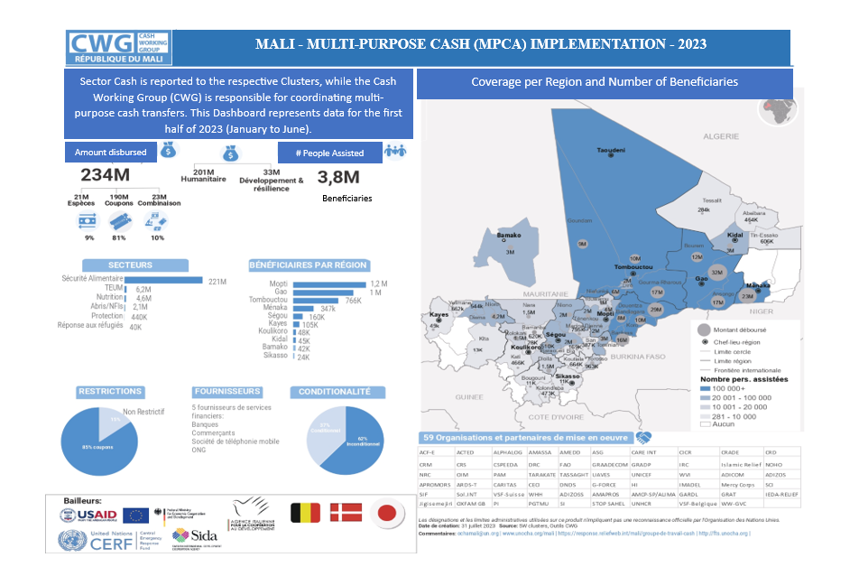

Slide 4
SUPPORT FROM KEY DONORS
USAID/BHA and ECHO support MPCA in Mali and its integration in HRP

Slide 5
CHALLENGES IN IMPLEMENTING THE MPCA IN MALI
Security risks (restrictions, presence of armed groups)
Difficult humanitarian access
Financial services providers charging high rates
Market instability/volatility/inflation

Slide 6
BENEFITS (CWG)
Cost-effectiveness: MPCA is probably cheaper and quicker than in-kind distributions.
Freedom of choice: MPCA allows spending according to priorities.
Multiplier: MPCA has beneficial effects on local markets.
Flexibility: MPCA can be spent on both food and non-food items.
Empowerment: Contributes to improving the status of women and marginalized groups.

Slide 7
MPCA INTEGRATION IN HRP 2024 (ICCG Agreement)
To promote multi-sectoral responses (Protection, Shelter/NFI, Health, Education, WASH, Food Security, Nutrition).
Target: To be extracted from the number of targeted populations (not from the PIN)

Slide 8
MPCA BUDGET
ICCG Recommendation: Each Cluster to allocate minimum of 7.5% of their target for MPCA.
MPCA Budget = Min7.5% Target * MEB

Slide 9
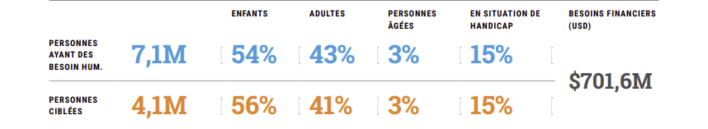
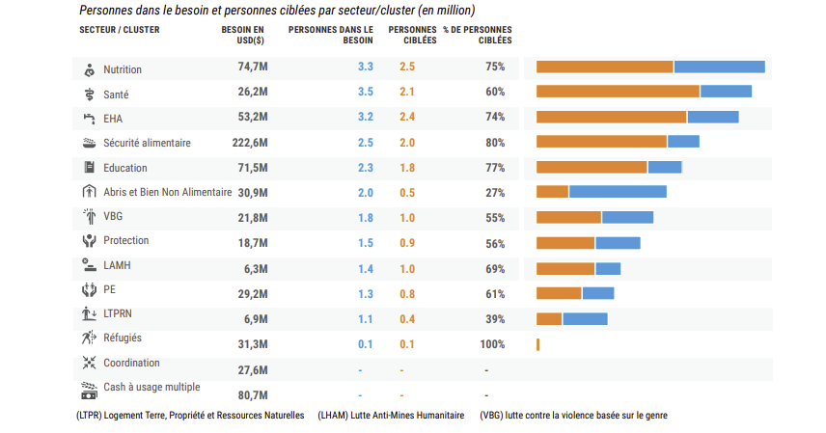
HRP 2024 – MALI
Financial Requirements
Budget Shelter/NFI | Budget MPCA (7.5%)
USD 30,900,000 | USD 2,317,500
MPCA (11.5%)

Slide 10
THANK YOU

